Slide 1


Slide 2
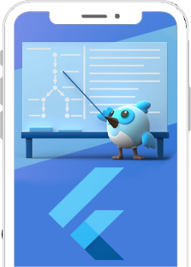

Table Of Contents
Introduction To Flutter
Advantages of Flutter
Dart Programming Language
State Management
Code Example
My Experience
Conclusion
Q&A

Slide 3
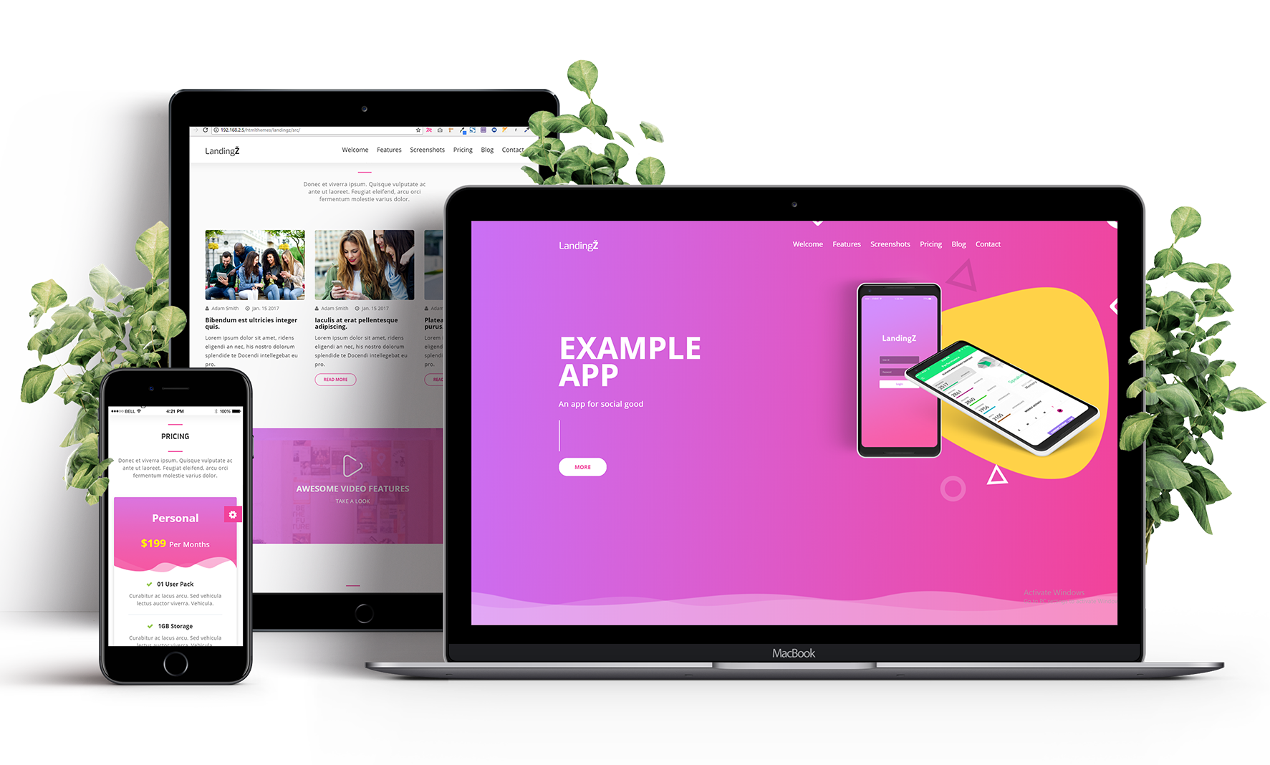
Introduction to Flutter
1
2
Why choose Flutter?
What is Flutter?
A free and open-source UI software development kit created by Google
One codebase for both iOS and Android apps, faster development, and hot reload feature for quick testing and bug fixing

Slide 4

Advantages of using Flutter
Hot Reload
Rich Set of
Customizable
Widgets
Allows for real-time code updates, making it easier to fix bugs and iterate on designs quickly
Cross-Platform Capabilities
Flutter provides a comprehensive library of pre-built widgets that can be easily customized to create complex and visually appealing user interfaces.
Flutter offers easy-to-use cross-platform support for iOS and Android, and has the ability to integrate into Web, Desktop or other platforms

Slide 5
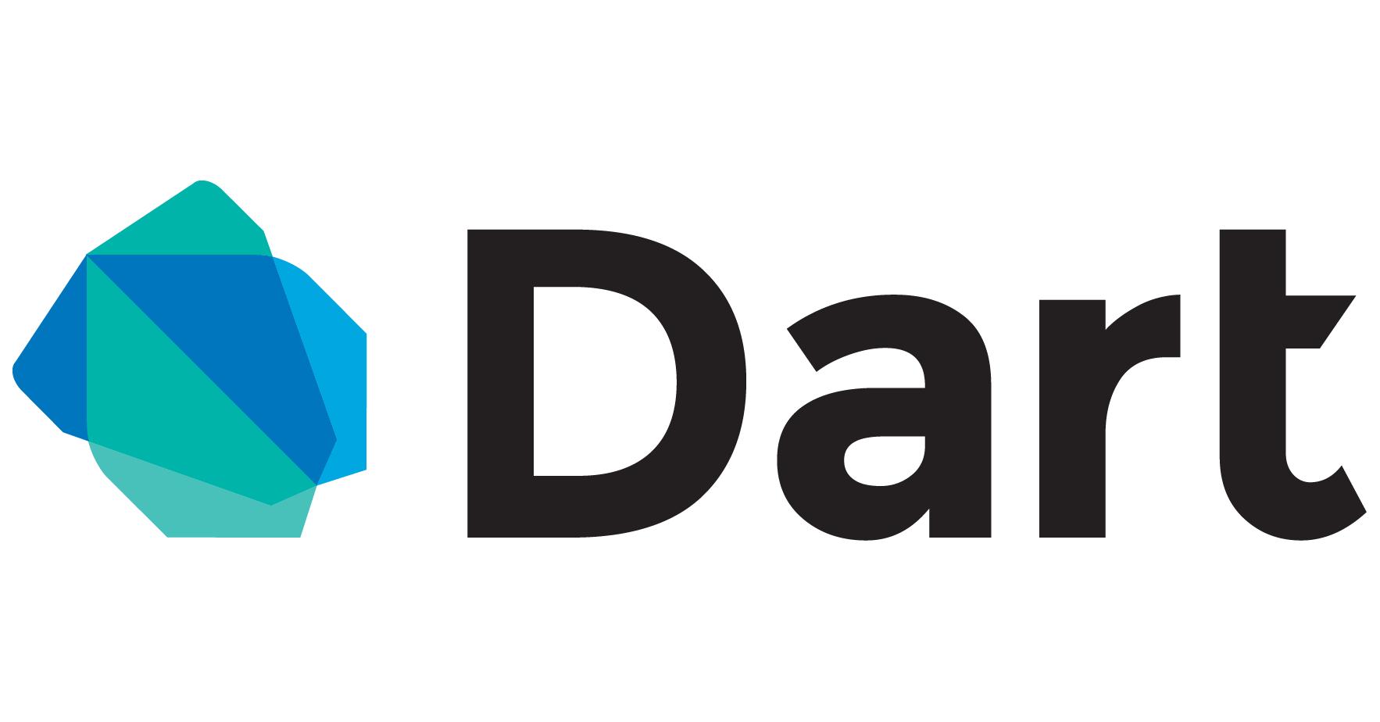
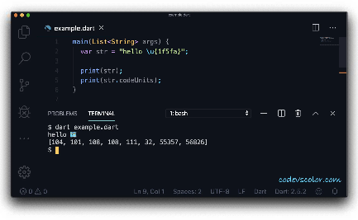
Dart programming language
What is Dart?
How is Dart used in Flutter?
A client-optimized language for fast apps on any platform, commonly used to build web, server, and mobile apps
Flutter uses Dart language to express the UI of the app and all application logic.

Slide 6
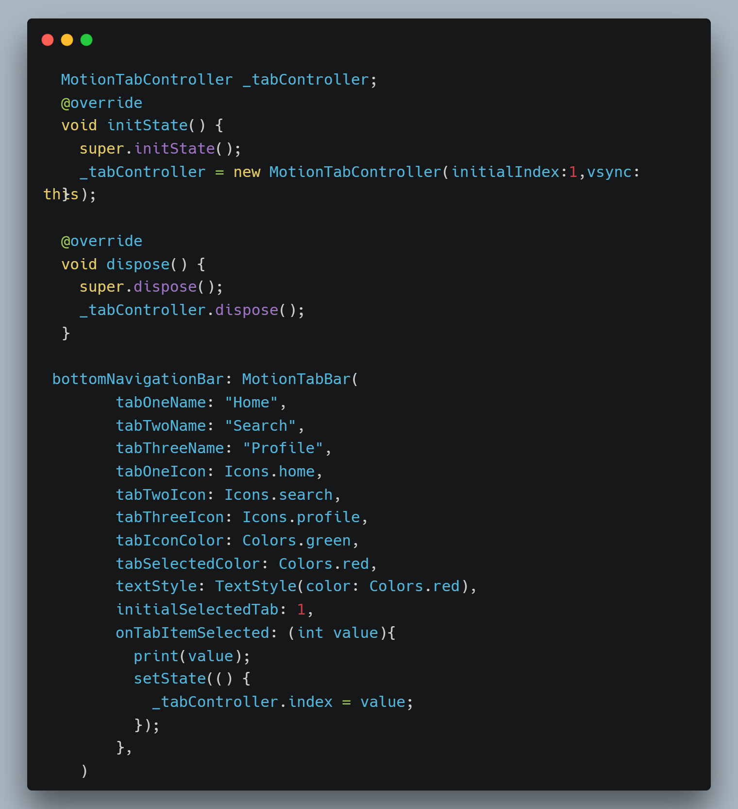
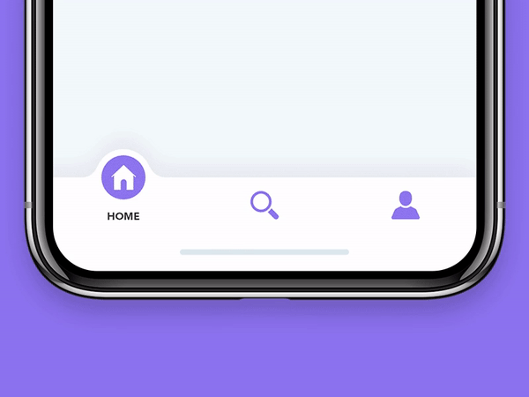
Exploring the Code
Output

Slide 7
State management in Flutter
What is State Management?
Why is it important?
How is it done in Flutter?
The management of application state to make sure the UI reflects the correct state during the application flow.
State management helps to reduce bugs, improve app stability, and enhance the user experience.
Flutter provides various state management techniques and packages like Provider and Bloc, that make it easier to manage state in a clean and efficient manner.

Slide 8
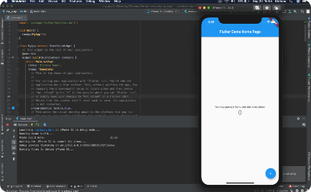
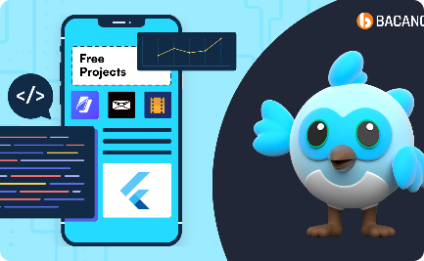

My experience with Flutter
What I've Created with Flutter
My Community
Me in Action
I've contributed to several Flutter apps in the community.
Also got to learn many new things from community and educating begginers with
I’ve created many apps in flutter including :
Grid-Master (Tic-Tac-Toe)
SinixNotes (Note App)
Do It (To-Do List App)
E-Commerce App
Chatty (Social Media App)
I have joined the largest flutter community “HeyFlutter.com” in 2022.
I have been working with all the community members by open sourcing and solving each others errors.

Slide 9
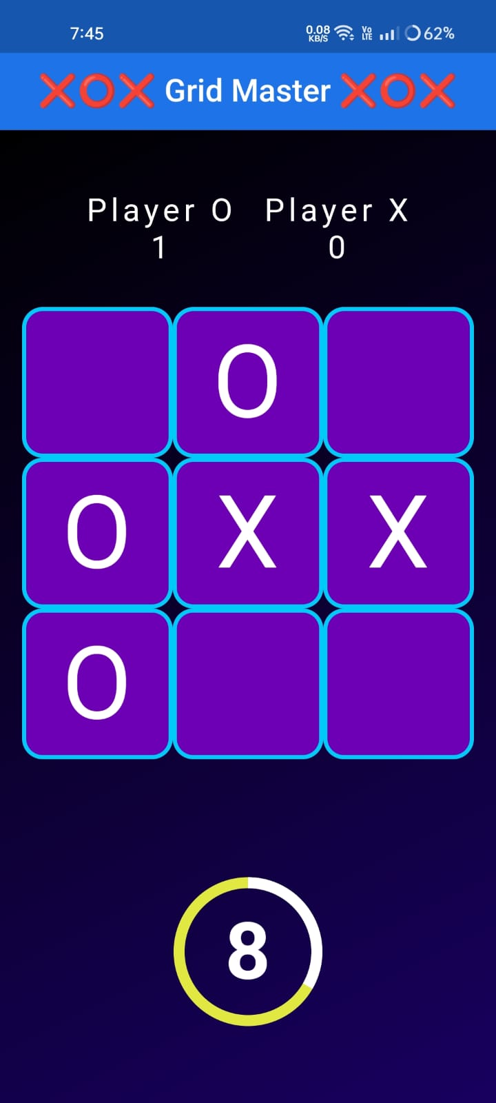
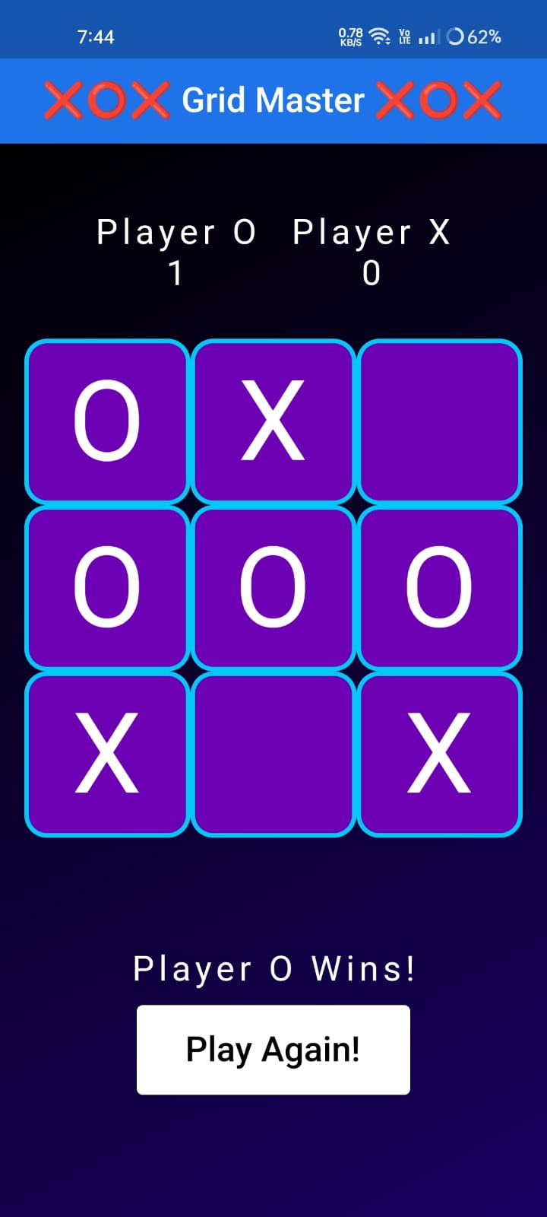
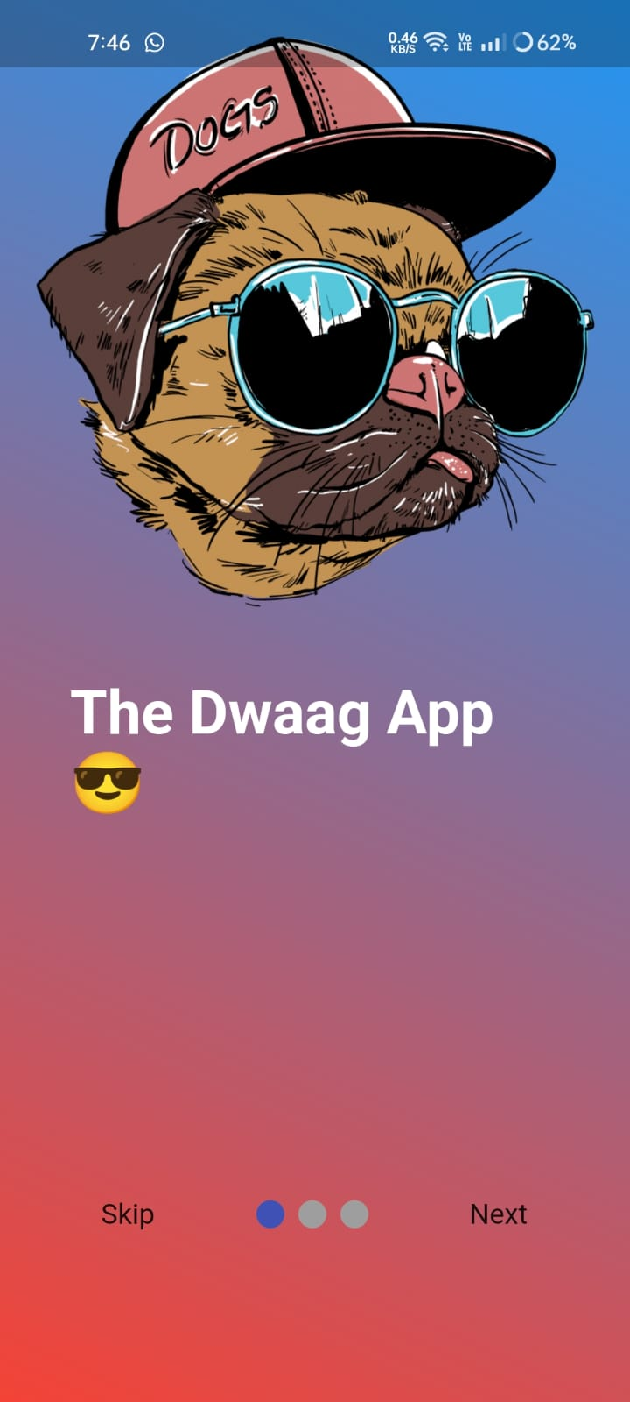
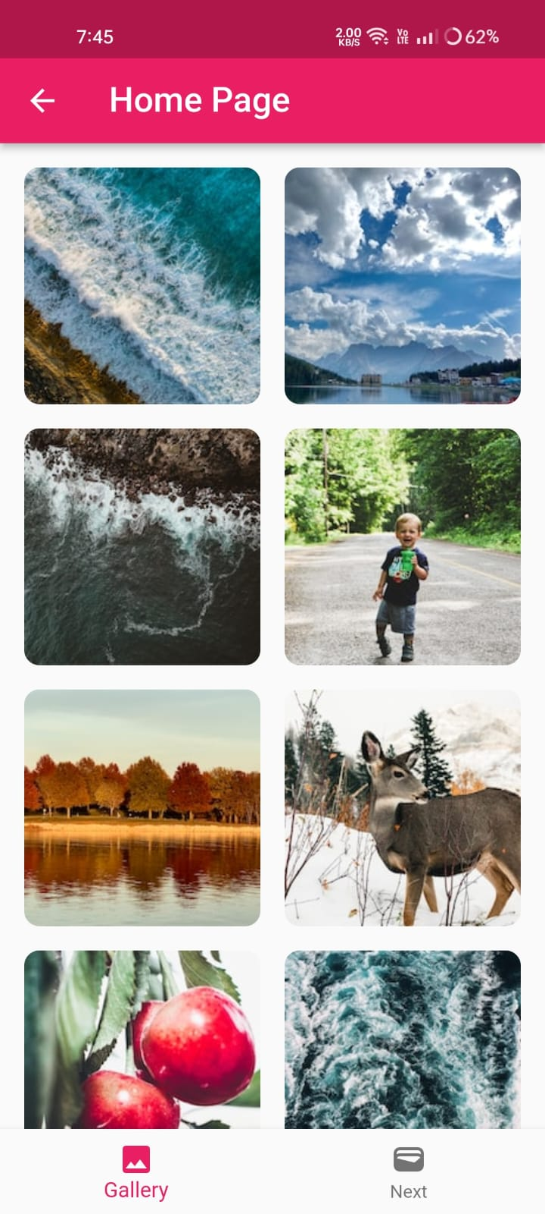
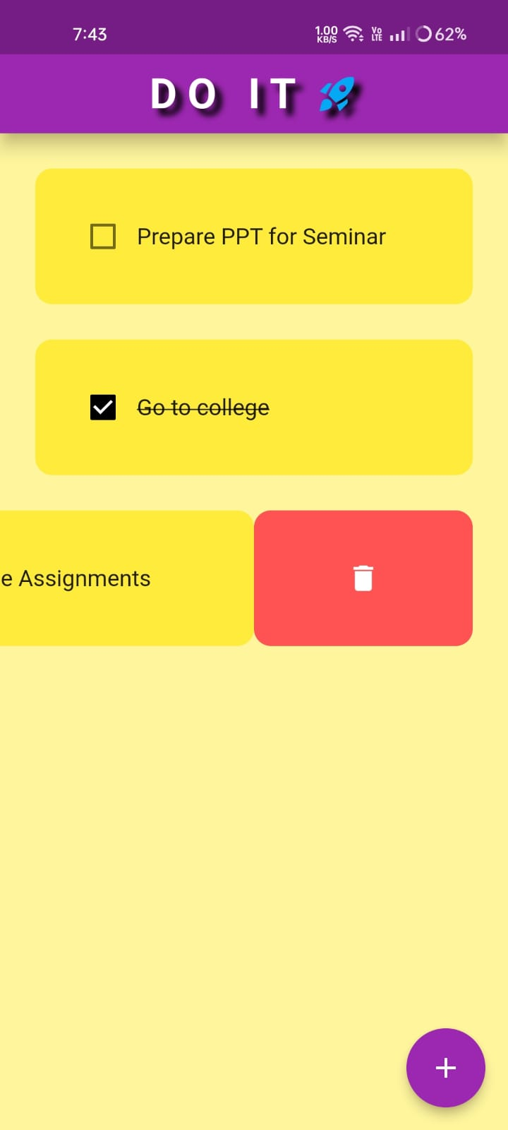
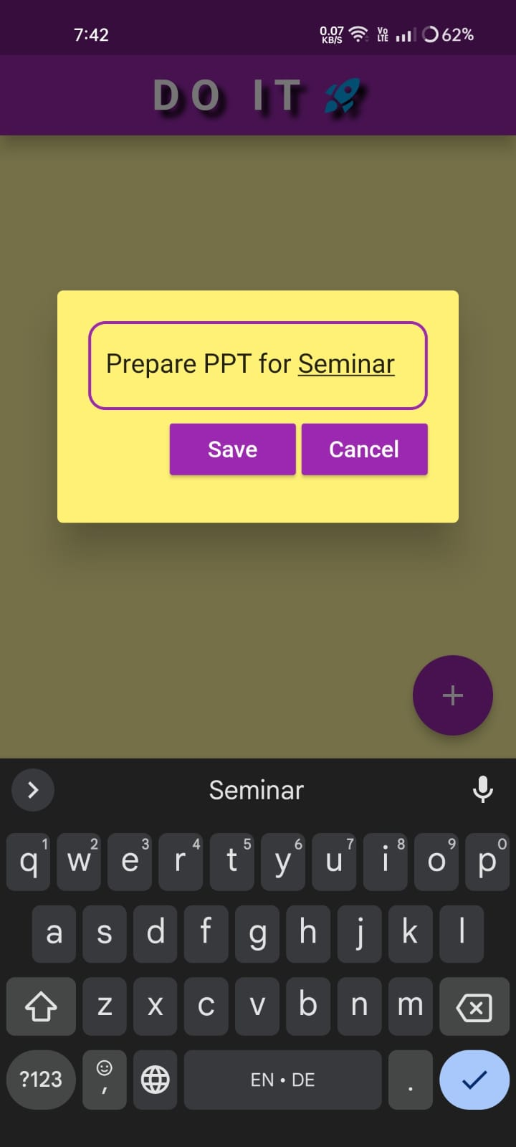
🔗 Do It - Apps on Google Play
Do It
Grid – Master
🔗Grid-Master : Amazon App-Store
The Dwaag App

Slide 10

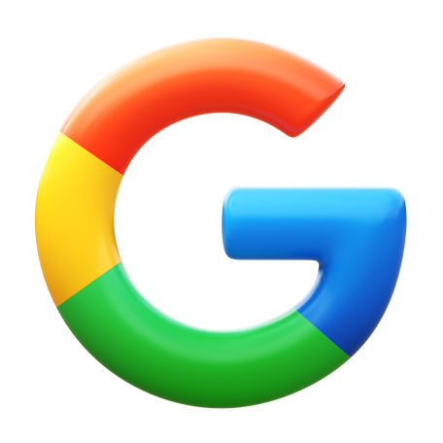
Users Of Flutter

Slide 11

Future Scope
Many top-level companies are using flutter hence can be considered as safe future for long time
2. Developers friendly and liked
3. Frequent updates : hence durable and self improving
4. Google promoting and convincing many companies to switch to flutter

Slide 12
Conclusion
References
Flutter is a Single codebase, multi-platform reach, native-like performance—ideal for efficient, expressive app development. With a rich widget library and hot reload feature, developers enjoy rapid iteration and a vibrant community, making Flutter a top choice in the tech landscape.
🔗 Flutter - Build apps for any screen
🔗 Dart programming language | Dart

Slide 13
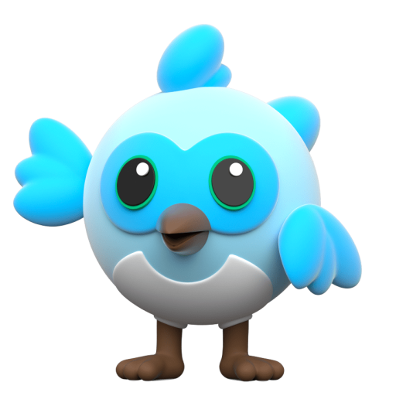
Thank You
Guide By -
U. C. Khake Ma’am
Interested in flutter? : Ask me !!

